Slide 1
REDDIT MACHINE LEARNING POST CLASSIFICATION
Predicting Subreddits From Posts
Notes:
Hello and welcome!
This is a presentation on a prototype for a machine learning method for classifying subreddits from posts.

Slide 2

WELCOME!
Christopher Landschoot
I am a Data Scientist leading the team hired by Reddit for this project.
Notes:
My name is Chris Landschoot
I am a data scientist leading a team that was hired by Reddit to solve this challenge.

Slide 3
BACKGROUND
The internet has been flooded with data and it is becoming increasingly hard to determine the validity of content.
Additionally, this data provides opportunities to glean information about whoever creates it.
As Reddit has continued to increase in size, the amount of data they collect has increased as well.
Reddit is interested in finding new ways to analyze the data on their site in order to better inform their moderation policies, target marketing, and analyze general trends of their users.
Notes:
The internet has been flooded with data and it is becoming increasingly hard to determine the validity of content.
Additionally, this data provides opportunities to glean information about whoever creates it.
As Reddit has continued to increase in size, the amount of data they collect has increased as well.
Reddit is interested in finding new ways to analyze the data on their site in order to better inform their moderation policies, target marketing, and analyze general trends of their users.

Slide 4
PROBLEM STATEMENT
Reddit is seeking to create a machine learning model that can accurately classify which subreddit a post originates from solely based on its text.
To achieve this, Reddit has hired my team of data scientists to create a proof-of-concept model that will be trained on 2 subreddits.
Success will be measured by achieving:
Accuracy of classification > 95%
Precision and Recall of classification > 90%
If successful, financial resources will be allocated to developing this technology to be generalized to the entire site.
Notes:
Reddit is seeking to create a machine learning model that can accurately classify which subreddit a post originates from solely based on its text.
To achieve this, Reddit has hired my team of data scientists to create a proof-of-concept model that will be trained on 2 subreddits.
Success will be measured by achieving:
An Accuracy of classification > 95%
And Precision and Recall metrics > 90%
If successful, financial resources will be allocated to developing this technology to be generalized to the entire site.
So now I am going to take you through how we created this model and how it performs…

Slide 5
THE DATA SCIENCE PROCESS
01
03
02
04
Data Collection
Preprocessing
Collecting posts from two subreddits.
Natural Language Processing (NLP) of the text data.
Exploratory Data Analysis
Modeling
Optimizing multiple models and ensembling.
Analyzing trends in the data.
Notes:
The process is broken down into 4 steps
First, Data collection is where we collect posts from 2 subreddits
Second, Exploratory data analysis is where we process the data and review its trends
Third, Preprocessing is where we use specialized natural language processing (or NLP) techniques to help the model understand the data better
And Fourth, Modeling, is where we test various models and parameters to optimize for best performance.
Let’s start with… Data Collection

Slide 6
01
Data Collection
Notes:
Data Collection

Slide 7

Notes:
We collected data from 2 subreddits with similar topics. This was to make sure that the model would work, even if language used in different subreddits was similar.
We selected the audiophile and guitar subreddits, because our team has a passion for sound and music.

Slide 8
DATA COLLECTION
Posts from r/audiophile and r/guitar were collected.
4000 posts per subreddit were collected.
All posts contain only text (no title, comments, author, etc.).
All posts are unique.
Notes:
4000 posts from each of these subreddits were collected.
All posts contain only text (not the title, comments, author, or anything else). This was to ensure the model would work without any other context clues.
All posts are unique so that the model wasn’t trained on duplicated data
Once the data was collected… It was cleaned and then we moved on to data analysis

Slide 9
02
Exploratory Data Analysis
Notes:
Once the data was collected… It was cleaned and then we moved on to data analysis

Slide 10
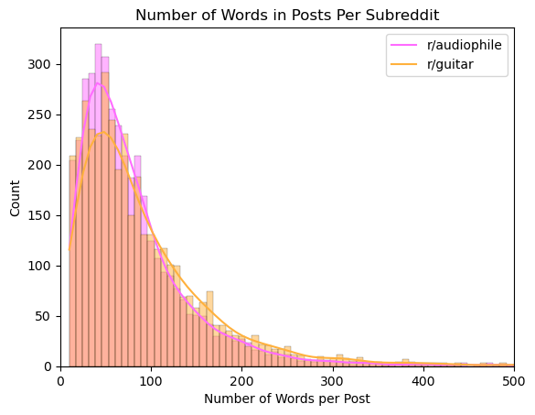
POST DISTRIBUTION
Notes:
This is the distribution of post length by word for each subreddit
This plot clearly shows that the data are heavily right skewed.
Post lengths averaged about 89 words per post, though the median of 67 words likely better describes the typical post length due to the heavy skew in the data.
The max post length is a whopping 1534 words. This plot has been adjusted for better visualization, so some of the outliers are not shown.
Generally, posts from the guitar subreddit were a bit more verbose than the audiophile subreddit.
We also looked at… The most common words of each subreddit

Slide 11
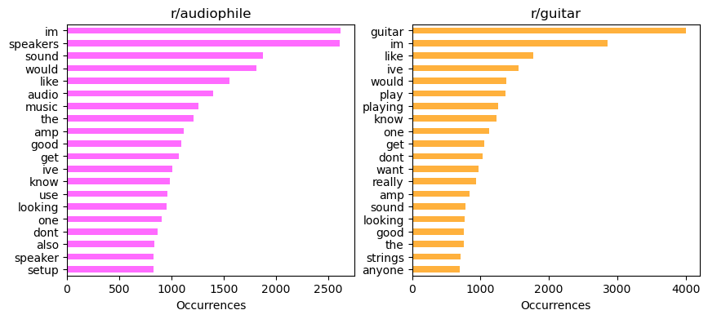
MOST COMMON WORDS
Notes:
The most common words of each subreddit
Many commonly used words are relatively neutral (I’m, like, would, the, etc.)
However, there are also some more subreddit-specific words that arise in this analysis (guitar, speakers, sound, audio, etc.)
Another thing to notice is that some of the neutral words and specific words are shared between each subreddit because they have similar topics.
This is a good finding because a critical aim of this prototype model is to be able to differentiate between two subreddits even though they are related in topic like this.
From these trends, decisions were made about how to process the data in the next step… Natural Language Processing (or NLP)

Slide 12
03
Natural Language Processing
Notes:
Natural Language Processing (or NLP)

Slide 13
NATURAL LANGUAGE PROCESSING
Stopwords Removed
Stemming Words
Common English words were removed.
Words were reduced to their base form.
Lemmatizing Words
Commonly Shared Words Removed.
Words were reduced to their base form.
Single words, bigrams, and trigrams.
Notes:
The purpose of NLP is to translate our language to a format that makes it more easy for computers to understand.
First, we removed stopwords. Stopwords are a set of commonly used words, so they are removed because they do not add any additional information to the model.
The text was stemmed and lemmatized separately.
Stemming and lemmatizing both perform similar tasks, essentially shortening words to the base of the word as a way of sort of grouping similar words together (for example turning jumping and jumped all into jump).
Ultimately only the stemmed text was used in the model because there was negligible performance difference between the two methods and stemming is more computationally efficient. So when this model is adapted to generalize to the entire website, this efficiency will be beneficial.
And finally, words, bigrams (pairs of words), and trigrams (sets of 3 words) that were shared between the top 50 most common words of each dataset were removed. This step helps the models differentiate the two datasets further.
After processing the data, we then began… Modeling

Slide 14
04
Modeling
Notes:
Modeling

Slide 15
MODELS
Multinomial Naïve Bayes
Logistic Regression
Random Forest
Extra Trees
Gradient Boosting
XGBoost
Support Vector Machine
Notes:
A bag-of-words approach was taken for this classification problem. This essentially means that the order of the words was not important to the model.
Seven different models were tested
Multinomial Naive Bayes
Logistic Regression
Random Forest
Extra Trees
Gradient Boosting
XGBoost
Support Vector Machine (SVM)
So many models were tested because they each have different benefits and drawbacks.
Of the seven models…

Slide 16
MODELS
Multinomial Naïve Bayes
96% Accurate
, Best Recall
96% Accurate
Logistic Regression
Random Forest
Extra Trees
Gradient Boosting
XGBoost
Support Vector Machine
96.2% Accurate
, Best Precision
Notes:
Of the seven models…
Multinomial Naïve Bayes, Logistic Regression, and SVM performed the best
***All were 96% accurate or better
However, these three models had quite different performances when it came to the other important success metrics. Namely, precision and recall.
Precision essentially measures how accurate the model’s positive predictions are (in our case the guitar subreddit)
Recall essentially measures how sensitive the model is to this positive category
***SVM had the highest precision and Naïve Bayes had the highest Recall
Because these models all performed well, but had different strengths…

Slide 17
Ensembled Model
Support Vector Machine
Multinomial Naïve Bayes
Logistic Regression
96.6% Accurate
Notes:
We “ensembled” (or combined) them together.
This combination attempts to distill out the best qualities of each model to create a better overall performance as well as a more balanced model.
***This ensembled model improved the accuracy to 96.6% with a more balanced high precision and recall

Slide 18
CONCLUSIONS
Text data was processed using natural language processing techniques.
Stop words were removed.
Text was stemmed (reduced to base form).
Shared most common words were removed.
Seven separate models were tested. The best 3 (Multinomial Naïve Bayes, Logistic Regression, SVM) were combined into a final ensembled model.
Ensembled Model
Accuracy: 96.6% (>95% Success Metric)
Precision: 96.5% (>90% Success Metric)
Recall: 96.7% (>90% Success Metric)
Notes:
So let’s recap
We used NLP techniques to process the text data we collected from the two subreddits
Stop words were removed
Text was stemmed (reduced to base form).
The shared most common words were removed
Seven separate models were tested. The best 3 (Multinomial Naïve Bayes, Logistic Regression, SVM) were combined into a final ensembled model.
Ensembled Model
Accuracy: 96.6% (>95% Success Metric)
Precision: 96.5% (>90% Success Metric)
Recall: 96.7% (>90% Success Metric)

Slide 19
RECOMMENDATIONS
This prototype model exceeded the success metrics defined by Reddit.
Reddit should allocate financial resources to further develop this technology for the entire site.
Next Steps:
Introduce sentiment analysis.
Introduce additional data to the model, including title of post, comments, author, upvotes, etc.
Test other NLP methods (other than bag-of-words).
Notes:
Based on these conclusions, we recommend that Reddit should allocate financial resources to further develop this technology for the entire site.
Next Steps:
Introduce sentiment analysis
Introduce additional data to the model, including title of post, comments, author, upvotes, etc.
Test other NLP methods (other than bag-of-words)
DON’T SAY THESE:
Word embeddings: Word embeddings represent words as vectors in a high-dimensional space, where words with similar meanings are closer together. This method captures semantic relationships between words and can be used in a variety of NLP tasks.
Sequence models: Sequence models, such as recurrent neural networks (RNNs) and long short-term memory (LSTM) networks, are designed to handle sequential data, such as text. These models can capture the order of words in a sentence and learn to predict the next word in a sequence.
Transformer models: Transformer models, such as BERT and GPT-3, use attention mechanisms to process entire sequences of words at once, allowing them to capture the context and meaning of words in a sentence or document. These models have achieved state-of-the-art performance on many NLP tasks.
Syntax-based methods: Syntax-based methods use grammatical structure and relationships between words to analyze text. For example, dependency parsing can be used to identify the subject and object of a sentence and how they relate to each other.

Slide 20
THANKS!
Any Questions?
Notes:
Thank you for your time.
Are there any questions?

